Slide 1
Combinational Logic I
CSCI 2050U - Computer Architecture
Randy J. Fortier
@randy_fortier

Slide 2
Outline
Equivalent forms:
Boolean algebraic expressions
Truth tables
Digital circuit diagrams
Arithmetic operations

Slide 3
Digital Logic Representations
Truth Tables, Boolean Algebra, Digital Circuit Diagrams
CSCI 2050U - Computer Architecture

Slide 4
Equivalent Representations
The following representations are equivalent:
Truth table
Boolean algebraic expression
Digital circuit diagram

Slide 5
Truth Table
A truth table is a table which includes an exhaustive list of all possible input values and the corresponding output values
We’ve seen truth tables for basic operations/gates in the previous section
You can create a truth table for any function that always has the same output for each input combination

Slide 6
Truth Table
Let’s do an example: A truth table for adding one to an unsigned number
a2 | a1 | a0 | b2 | b1 | b0
0 | 0 | 0 | 0 | 0 | 1
0 | 0 | 1 | 0 | 1 | 0
0 | 1 | 0 | 0 | 1 | 1
0 | 1 | 1 | 1 | 0 | 0
1 | 0 | 0 | 1 | 0 | 1
1 | 0 | 1 | 1 | 1 | 0
1 | 1 | 0 | 1 | 1 | 1
1 | 1 | 1 | 0 | 0 | 0
Notes:
Note the pattern in the inputs. This can be extended to any number of input variables.

Slide 7
Truth Table
Let’s do another example: A truth table for performing twos complement
a2 | a1 | a0 | b2 | b1 | b0
0 | 0 | 0 | 0 | 0 | 0
0 | 0 | 1 | 1 | 1 | 1
0 | 1 | 0 | 1 | 1 | 0
0 | 1 | 1 | 1 | 0 | 1
1 | 0 | 0 | 1 | 0 | 0
1 | 0 | 1 | 0 | 1 | 1
1 | 1 | 0 | 0 | 1 | 0
1 | 1 | 1 | 0 | 0 | 1

Slide 8
Boolean Algebra
Boolean algebra is just like normal algebra:
Variables
Operators
Axioms - universal truths (e.g. ab = ba, a(b + c) = ab + ac)
The key difference is that variables contain Boolean values
Their value is either True or False
The operators and axioms are also a bit different

Slide 9
Boolean Algebra
Boolean algebraic operators:
NOT
AND
OR
NAND
NOR
XOR
Except for XOR, we’ve seen all of these (as gates) in the first section

Slide 10
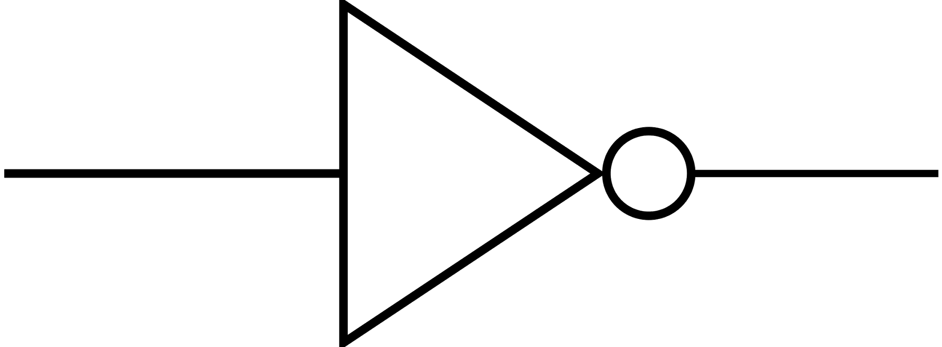
Boolean Operators
Inverter:
A | NOT A (A’, A, ¬A)
0 | 1
1 | 0

Slide 11
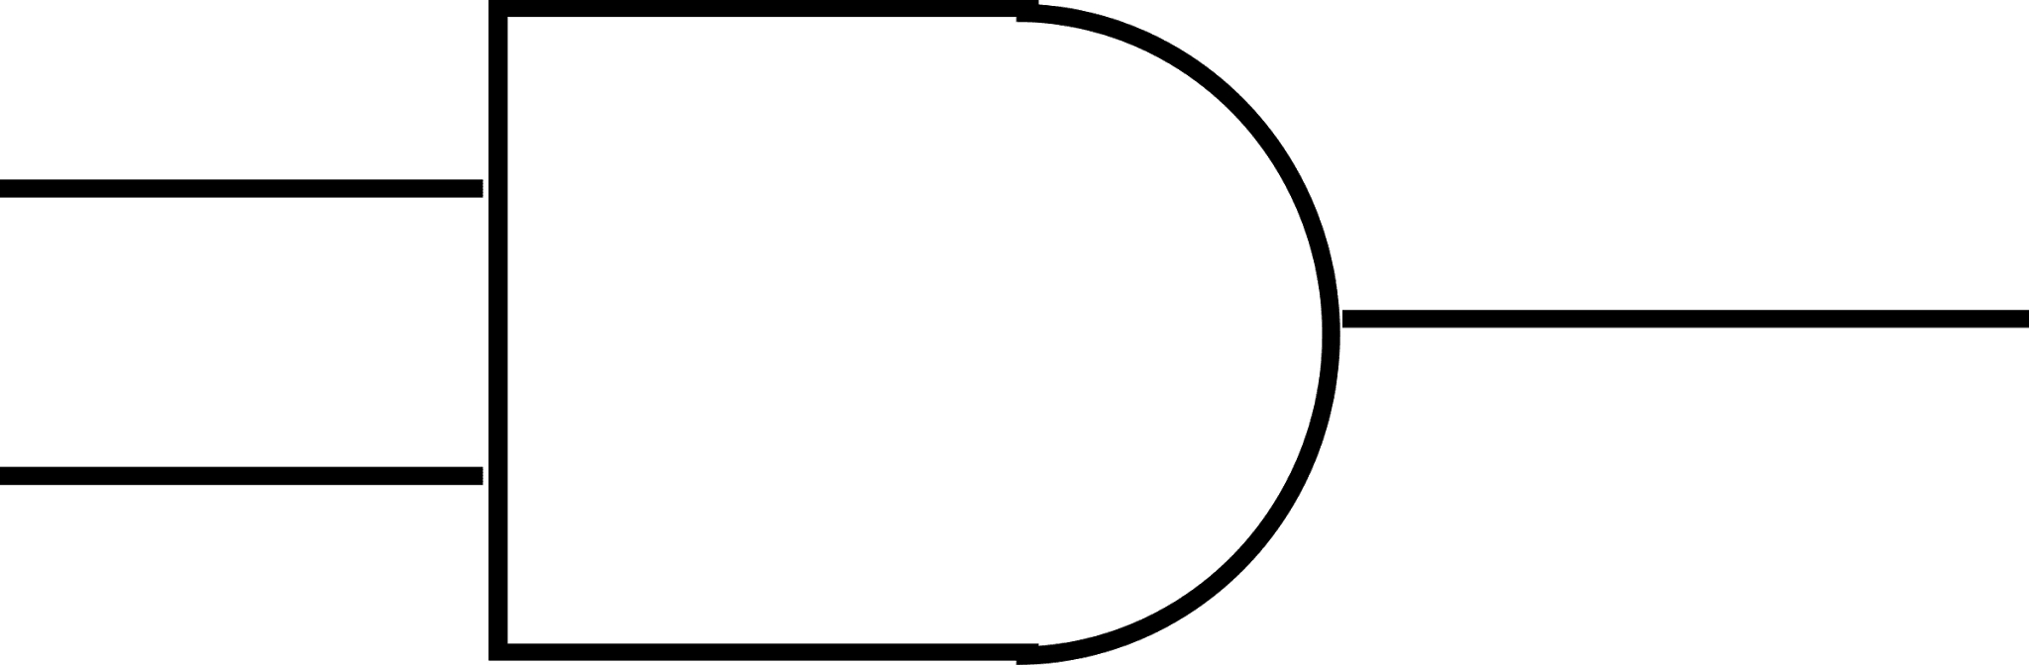
Boolean Operators
AND:
A | B | A AND B (AB, A⋀B)
0 | 0 | 0
0 | 1 | 0
1 | 0 | 0
1 | 1 | 1

Slide 12
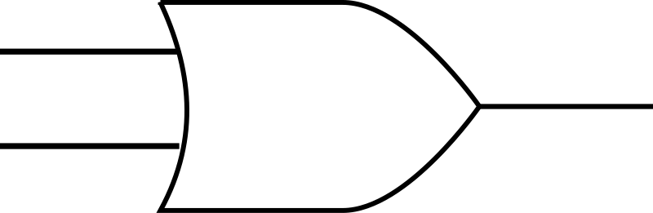
Boolean Operators
OR:
A | B | A OR B (A+B, A⋁B)
0 | 0 | 0
0 | 1 | 1
1 | 0 | 1
1 | 1 | 1

Slide 13

Boolean Operators
NOR:
A | B | A NOR B
0 | 0 | 1
0 | 1 | 0
1 | 0 | 0
1 | 1 | 0
Note: This gate is extremely useful in circuit design, but uncommon in Boolean algebra

Slide 14
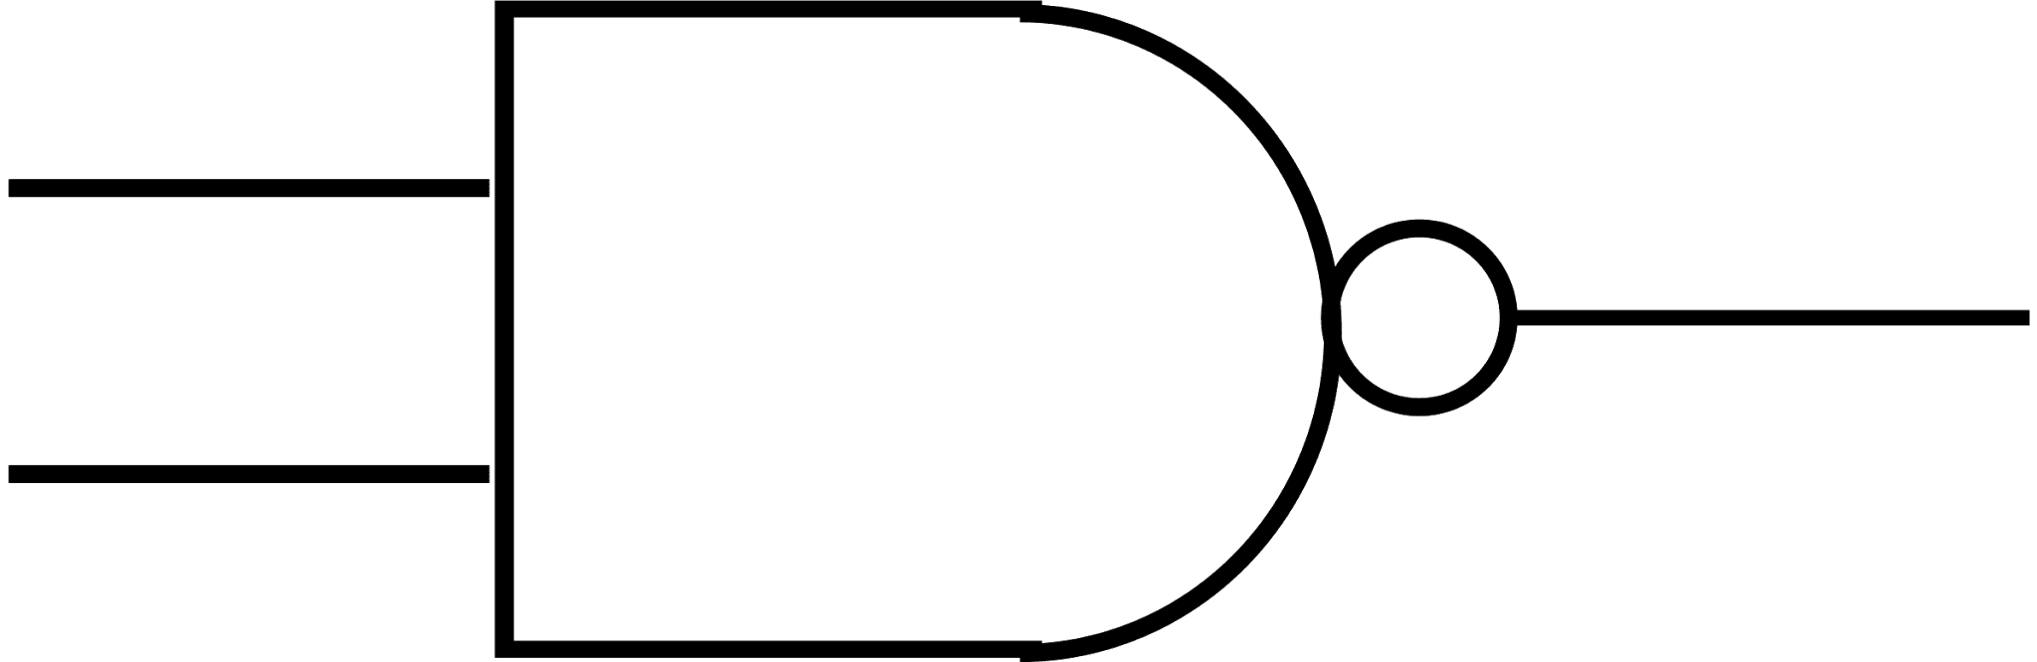
Boolean Operators
NAND:
A | B | A NAND B
0 | 0 | 1
0 | 1 | 1
1 | 0 | 1
1 | 1 | 0
Note: This gate is extremely useful in circuit design, but uncommon in Boolean algebra

Slide 15

Boolean Operators
XOR:
A | B | A XOR B (A ⊕ B)
0 | 0 | 0
0 | 1 | 1
1 | 0 | 1
1 | 1 | 0
Note: This gate is extremely useful in circuit design, but uncommon in Boolean algebra

Slide 16
Boolean Algebraic Expressions
f(x,y,z) = xy + xz + yz
Both x and y, OR
Both x and z, OR
Both y and z
x | y | z | f(x, y, z)
0 | 0 | 0 | 0
0 | 0 | 1 | 0
0 | 1 | 0 | 0
0 | 1 | 1 | 1
1 | 0 | 0 | 0
1 | 0 | 1 | 1
1 | 1 | 0 | 1
1 | 1 | 1 | 1

Slide 17
Boolean Algebraic Expressions
Let’s do an example:
f(x,y,z) = xy’ + xz’ + yz
x | y | z | f(x, y, z)
0 | 0 | 0 | 0
0 | 0 | 1 | 0
0 | 1 | 0 | 0
0 | 1 | 1 | 1
1 | 0 | 0 | 1
1 | 0 | 1 | 1
1 | 1 | 0 | 1
1 | 1 | 1 | 1

Slide 18
Boolean Algebraic Expressions
A Boolean algebraic expression is satisfiable iff there is at least one combination of variable values that makes the expression true
x | y | xy’
0 | 0 | 0
0 | 1 | 0
1 | 0 | 1
1 | 1 | 0

Slide 19
Boolean Algebraic Expressions
A Boolean algebraic expression is unsatisfiable iff there is no combination of variable values that makes the expression true
x | y | (x+y’)x’y
0 | 0 | 0
0 | 1 | 0
1 | 0 | 0
1 | 1 | 0

Slide 20
Boolean Algebraic Expressions
A Boolean algebraic expression is universally valid iff the expression true for every combination of variable values
x | y | x’y + x’y’ + x
0 | 0 | 1
0 | 1 | 1
1 | 0 | 1
1 | 1 | 1

Slide 21
Boolean Algebraic Expressions
Two Boolean algebraic expressions are logically equivalent iff for each combination of variable values, they produce the same output
x | y | x’y’ | (x + y)’
0 | 0 | 1 | 1
0 | 1 | 0 | 0
1 | 0 | 0 | 0
1 | 1 | 0 | 0

Slide 22
Sum of Products (SOP) Form
For the output b in the truth table given, what input values make it true?
a2 | a1 | a0 | b
0 | 0 | 0 | 0
0 | 0 | 1 | 1
0 | 1 | 0 | 1
0 | 1 | 1 | 0
1 | 0 | 0 | 0
1 | 0 | 1 | 1
1 | 1 | 0 | 1
1 | 1 | 1 | 0

Slide 23
Sum of Products (SOP) Form
For the output b in the truth table given, what input values make it true?
Can we come up with a Boolean algebraic expression for this row?
a2 | a1 | a0 | b
0 | 0 | 0 | 0
0 | 0 | 1 | 1
0 | 1 | 0 | 1
0 | 1 | 1 | 0
1 | 0 | 0 | 0
1 | 0 | 1 | 1
1 | 1 | 0 | 1
1 | 1 | 1 | 0

Slide 24
Sum of Products (SOP) Form
For the output b in the truth table given, what input values make it true?
Can we come up with a Boolean algebraic expression for this row?
a2 = 0, a1 = 0, a0 = 1
a2’a1’a0
a2 | a1 | a0 | b
0 | 0 | 0 | 0
0 | 0 | 1 | 1
0 | 1 | 0 | 1
0 | 1 | 1 | 0
1 | 0 | 0 | 0
1 | 0 | 1 | 1
1 | 1 | 0 | 1
1 | 1 | 1 | 0
a2’a1’a0

Slide 25
Sum of Products (SOP) Form
For the output b in the truth table given, what input values make it true?
Extending this to all of the true rows...
a2 | a1 | a0 | b
0 | 0 | 0 | 0
0 | 0 | 1 | 1
0 | 1 | 0 | 1
0 | 1 | 1 | 0
1 | 0 | 0 | 0
1 | 0 | 1 | 1
1 | 1 | 0 | 1
1 | 1 | 1 | 0
a2’a1’a0
a2’a1a0’
a2a1’a0
a2a1a0’

Slide 26
Sum of Products (SOP) Form
For the output b in the truth table given, what input values make it true?
Combining them together:
b = a2’a1’a0 + a2’a1a0’ + a2a1’a0 + a2a1a0’
This is called sum of products (SOP) form
It is a sum (+) of products (a2a1’a0)
Also called Disjunctive Normal Form (DNF)
a2 | a1 | a0 | b
0 | 0 | 0 | 0
0 | 0 | 1 | 1
0 | 1 | 0 | 1
0 | 1 | 1 | 0
1 | 0 | 0 | 0
1 | 0 | 1 | 1
1 | 1 | 0 | 1
1 | 1 | 1 | 0

Slide 27
Sum of Products (SOP) Form
Sum of products is very useful, due to:
How easily it can be converted into a circuit diagram
How easily the SOP form can be deduced from a truth table
A truth table for any expression can be straightforwardly created
It is not very efficient, however
It may not be the form that uses the fewest operators/gates
We’ll discuss optimization later

Slide 28
Circuit Diagrams
Let’s make a circuit that takes a 3-bit twos complement number, and outputs whether or not the number is negative:
We can make the truth table by simply looking at the numbers, and determining the correct output
a2 | a1 | a0 | Neg
0 | 0 | 0
0 | 0 | 1
0 | 1 | 0
0 | 1 | 1
1 | 0 | 0
1 | 0 | 1
1 | 1 | 0
1 | 1 | 1

Slide 29
Circuit Diagrams
Recall that the leftmost bit is 1 if the number is negative
This makes truth table quite easy to create
a2 | a1 | a0 | Neg
0 | 0 | 0 | 0
0 | 0 | 1 | 0
0 | 1 | 0 | 0
0 | 1 | 1 | 0
1 | 0 | 0 | 1
1 | 0 | 1 | 1
1 | 1 | 0 | 1
1 | 1 | 1 | 1

Slide 30
Circuit Diagrams
Now, let’s determine the SOP for Neg:
Neg = a2a1’a0’ + a2a1’a0 + a2a1a0’ + a2a1a0
a2 | a1 | a0 | Neg
0 | 0 | 0 | 0
0 | 0 | 1 | 0
0 | 1 | 0 | 0
0 | 1 | 1 | 0
1 | 0 | 0 | 1
1 | 0 | 1 | 1
1 | 1 | 0 | 1
1 | 1 | 1 | 1

Slide 31
Circuit Diagrams
Finally, let’s create the circuit:
Neg = a2a1’a0’ + a2a1’a0 + a2a1a0’ + a2a1a0

Slide 32
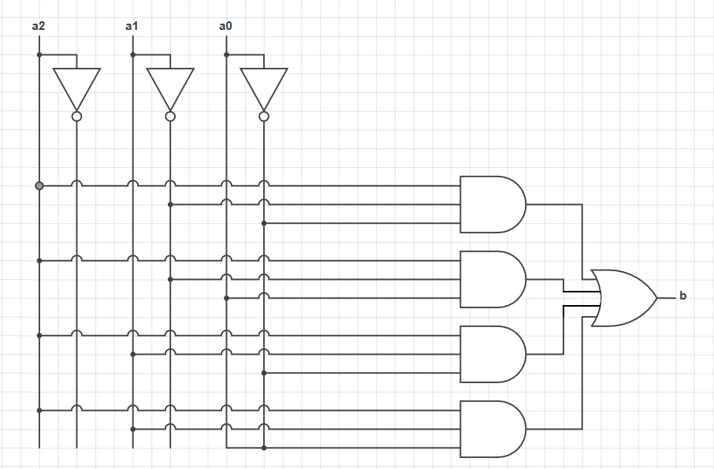
Circuit Diagrams
Finally, let’s create the circuit:
Neg = a2a1’a0’ + a2a1’a0 + a2a1a0’ + a2a1a0

Slide 33
Circuit Diagrams
Let’s make a circuit that takes a 2-bit input and generates the 2-bit output that is the input plus one
a1 | a0 | b1 | b0
0 | 0 | 0 | 1
0 | 1 | 1 | 0
1 | 0 | 1 | 1
1 | 1 | 0 | 0

Slide 34
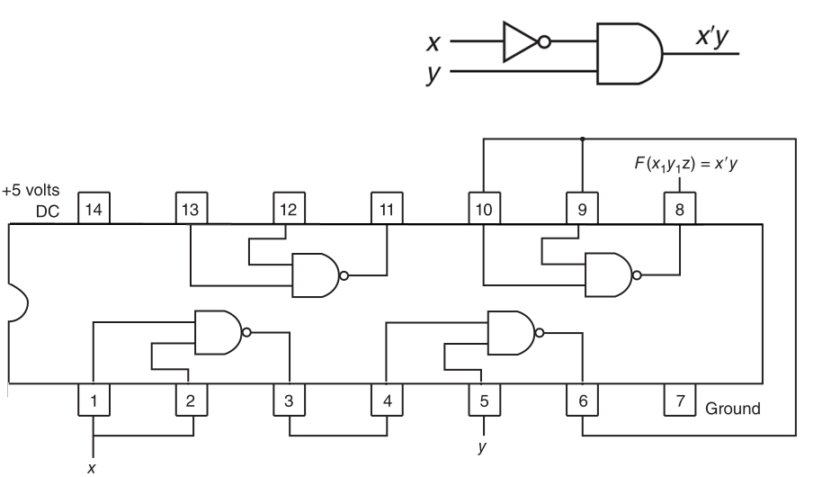

Implementing Circuits
If you don’t happen to have your own multi-billion dollar foundry, you can still build your own circuits using TTL chips (e.g. TI 7426)
Notes:
Verifying the equivalence of these two circuits is left as an exercise for the student.
Hint: Draw the truth tables (logical equivalence)

Slide 35
Arithmetic Operations
CSCI 2050U - Computer Architecture

Slide 36
Addition
We’ve seen how to do addition in a digital circuit
We’ve also previously explored how unsigned binary numbers are added
Adding signed (twos complement) numbers involves the same process
Which is good, since we won’t need a separate circuit
1 11
0010 1001 (41)
+ 0100 1011 (75)
0111 0100 (116)
111
1011 0101 (-75)
+ 0100 0111 (+71)
1111 1100 (-4)
Notes:
‹#›

Slide 37
Subtraction
Subtraction in binary can be done in a very similar way to subtraction in decimal
This works for both signed and unsigned binary numbers
0¹⁰
0100 1011 (75)
- 0010 1001 (41)
0010 0010 (34)
0¹⁰ 0¹⁰
1110 1101 (-19)
- 0001 0010 (+18)
1101 1011 (-37)
Notes:
‹#›

Slide 38
Subtraction by Addition
Subtraction can also be done by negating the subtrahend (the 2nd number) and adding
Subtracting signed numbers can be done the same way
The benefit is that we can use the same circuit for adding/subtracting
0100 1011 (75)
- 0010 1001 (41)
1 1 11 111
0100 1011 (75)
+ 1101 0111 (-41)
0010 0010 (34)
1001 0111 (-105)
- 1101 1011 (-37)
111
1001 0111 (-105)
+ 0010 0101 (+37)
1011 1100 (-68)
Notes:
‹#›

Slide 39
Overflow - Unsigned Integers
Overflow means that the result of an arithmetic operation cannot be correctly represented in the number of bits available
For addition, this means that we’ve exceeded the bounds of our representation
With unsigned addition, overflow happens when we go beyond the limits of our representation
This is easily recognized by a carry out
1 111 111
1011 0101 (181)
+ 0101 0111 (87)
0000 1100 (12)
Notes:
‹#›

Slide 40
Overflow - Signed Integers
With signed integers, a carry out doesn’t indicate overflow
Can adding one positive and one negative signed integers ever result in overflow?
Notes:
‹#›

Slide 41
Overflow - Signed Integers
With signed integers, a carry out doesn’t indicate overflow
Can adding one positive and one negative signed integers ever result in overflow? No
Can adding two negative (or two positive) signed integers ever result in overflow?
Notes:
‹#›

Slide 42
Overflow - Signed Integers
With signed integers, a carry out doesn’t indicate overflow
Can adding one positive and one negative signed integers ever result in overflow? No
Can adding two negative (or two positive) signed integers ever result in overflow? Yes
Adding two negative signed integers should produce a negative result
Adding two positive signed integers should produce a positive result
Notes:
‹#›

Slide 43
Overflow - Signed Integers
Detecting overflow when adding signed integers:
Does the sign of the result match the sign of both of the input numbers?
No → overflow
1 111 1
1011 0101 (-75)
+ 1101 1001 (-39)
1000 1110 (-114)
1 111
1011 0101 (-75)
+ 1000 0011 (-125)
0011 1000 (+56)
Notes:
‹#›

Slide 44
Arithmetic Example
Create a signed overflow recognizer
V = a7’b7’c7 + a7b7c7’
a7 | b7 | c7 | V
0 | 0 | 0 | 0
0 | 0 | 1 | 1
0 | 1 | 0 | 0
0 | 1 | 1 | 0
1 | 0 | 0 | 0
1 | 0 | 1 | 0
1 | 1 | 0 | 1
1 | 1 | 1 | 0
Notes:
‹#›

Slide 45
Logical Shift
1 | 0 | 1 | 0
Logical shift left
Shift all bits toward the left
Shift zero into the rightmost position
Leftmost bit gets shifted out
Logical shift right
Shift all bits toward the right
Shift zero into the leftmost position
Rightmost bit gets shifted out
Logical shift left
0 | 1 | 0 | 0
1 | 0 | 1 | 0
Logical shift right
0 | 1 | 0 | 1
Notes:
‹#›

Slide 46
Logical Shift
Logical shift is used when you want to move bits into a more easily accessible position
e.g. If bits represent Boolean (flag) values
In some programming languages, the << and >> operators are used
Notes:
‹#›

Slide 47
Arithmetic Shift
1 | 0 | 1 | 0
Arithmetic shift left
Shift all bits toward the left
Shift zero into the rightmost position
Leftmost bit gets shifted out
Identical to logical shift left
Arithmetic shift right
Shift all bits toward the right
Duplicate the leftmost bit (the sign bit)
Rightmost bit gets shifted out
Arithmetic shift left
0 | 1 | 0 | 0
1 | 0 | 1 | 0
Arithmetic shift right
1 | 1 | 0 | 1
Notes:
‹#›

Slide 48
Arithmetic Shift
0 | 0 | 1 | 1
3
6
-6
0101
1
0110 (6)
-3
0010
1
0011 (3)
0 | 1 | 1 | 0
1 | 0 | 1 | 0
1 | 1 | 0 | 1

Slide 49
Arithmetic Shift
Arithmetic shift is used when you want to multiply/divide by powers of 2
Arithmetic shift left by one bit → multiply by 2 (assuming no overflow)
Arithmetic shift left by n bits → multiply by 2^{n}
Arithmetic shift right by one bit → divide by 2 (integer division)
Arithmetic shift right by n bits → divide by 2^{n}
-2
1 | 1 | 1 | 0
1 | 0 | 1 | 0
-6
Arithmetic shift left
Arithmetic shift right
-4
1 | 1 | 0 | 0
1 | 1 | 0 | 1
-3
Notes:
‹#›

Slide 50
Multiplying Binary Numbers
Arithmetic shift can be used to implement arbitrary multiplication
Multiply x by 13:
13x = 8x + 4x + 1x = 2³x + 2²x + 2⁰x
Arithmetically shift x to the left by 3
Arithmetically shift x to the left by 2
Arithmetically shift x to the left by 0
Add up these results
Notes:
‹#›

Slide 51
Multiplying Binary Numbers
Let’s do an example:
x = -2
y = 11
Notes:
‹#›

Slide 52
Multiplying Binary Numbers
Let’s do an example:
1 | 1 | 1 | 1 | 1 | 1 | 1 | 0
x = -2
y = 11
Notes:
‹#›

Slide 53
Multiplying Binary Numbers
Let’s do an example:
1 | 1 | 1 | 1 | 1 | 1 | 1 | 0
x = -2
y = 11
= 8 + 2 + 1
= 2³ + 2¹ + 2⁰
Notes:
‹#›

Slide 54
Multiplying Binary Numbers
Let’s do an example:
Arithmetic shift left by 3
1 | 1 | 1 | 1 | 0 | 0 | 0 | 0
1 | 1 | 1 | 1 | 1 | 1 | 1 | 0
x = -2
by 1
1 | 1 | 1 | 1 | 1 | 1 | 0 | 0
by 0
y = 11
= 8 + 2 + 1
= 2³ + 2¹ + 2⁰
1 | 1 | 1 | 1 | 1 | 1 | 1 | 0
Notes:
‹#›

Slide 55
Multiplying Binary Numbers
Let’s do an example:
Arithmetic shift left by 3
1 | 1 | 1 | 1 | 0 | 0 | 0 | 0
1 | 1 | 1 | 1 | 1 | 1 | 1 | 0
x = -2
by 1
1 | 1 | 1 | 1 | 1 | 1 | 0 | 0
by 0
y = 11
= 8 + 2 + 1
= 2³ + 2¹ + 2⁰
1 | 1 | 1 | 1 | 1 | 1 | 1 | 0
1 | 1 | 1 | 0 | 1 | 0 | 1 | 0
Notes:
‹#›

Slide 56
Multiplying Binary Numbers
Let’s do an example:
Arithmetic shift left by 3
1 | 1 | 1 | 1 | 0 | 0 | 0 | 0
-16
1 | 1 | 1 | 1 | 1 | 1 | 1 | 0
x = -2
by 1
-4
1 | 1 | 1 | 1 | 1 | 1 | 0 | 0
by 0
1 | 1 | 1 | 1 | 1 | 1 | 1 | 0
-2
y = 11
= 8 + 2 + 1
= 2³ + 2¹ + 2⁰
1 | 1 | 1 | 0 | 1 | 0 | 1 | 0
-22
Notes:
‹#›

Slide 57
Multiplying Binary Numbers - Booth’s Algorithm
Booth’s algorithm – a fast method of multiplying integers
We'll use the following variables:
Q - multiplier
M – multiplicand
Q' – stores low order bit
A – stores high order portion of result (low order portion in Q)
The number of steps is equal to the number of bits in M
For each step, we compare Q's least significant bit and Q':
Arithmetic shift - shift all bits once to the right, keeping leftmost
Add – A = A + M
Subtract – A = A - M
LSB of Q, Q' | Operation(s)
0,0 | Arithmetic shift
0,1 | Add, arithmetic shift
1,0 | Subtract, arithmetic shift
1,1 | Arithmetic shift
‹#›
Notes:
‹#›

Slide 58
Multiplying Binary Numbers
LSB of Q, Q' | Operation(s)
0,0 | Arithmetic shift
0,1 | Add, arithmetic shift
1,0 | Subtract, arithmetic shift
1,1 | Arithmetic shift
Example:
Let's multiply 7 * -3
Q = 7
M = -3
Q' = 0 (initially)
A = 0 (initially)
0000
0111
0
1101
A
Q
Q'
M
‹#›
Notes:
‹#›

Slide 59
Multiplying Binary Numbers
LSB of Q, Q' | Operation(s)
0,0 | Arithmetic shift
0,1 | Add, arithmetic shift
1,0 | Subtract, arithmetic shift
1,1 | Arithmetic shift
Example:
Step one
Operation(s) – Subtract, shift
0000
0111
0
1101
A
Q
Q'
M
‹#›
Notes:
‹#›

Slide 60
Multiplying Binary Numbers
LSB of Q, Q' | Operation(s)
0,0 | Arithmetic shift
0,1 | Add, arithmetic shift
1,0 | Subtract, arithmetic shift
1,1 | Arithmetic shift
Example:
Step one
Operation(s) – Subtract, shift
Subtract: A = A - M
0011
0111
0
1101
A
Q
Q'
M
0000 0000
-1101 +0011
----- -----
0011 0011
‹#›
Notes:
‹#›

Slide 61
Multiplying Binary Numbers
LSB of Q, Q' | Operation(s)
0,0 | Arithmetic shift
0,1 | Add, arithmetic shift
1,0 | Subtract, arithmetic shift
1,1 | Arithmetic shift
Example:
Step one
Operation(s) – Subtract, shift
Arithmetic shift
0011
0111
0
1101
Before:
A
Q
Q'
M
0001
1011
1
1101
After:
‹#›
Notes:
‹#›

Slide 62
Multiplying Binary Numbers
LSB of Q, Q' | Operation(s)
0,0 | Arithmetic shift
0,1 | Add, arithmetic shift
1,0 | Subtract, arithmetic shift
1,1 | Arithmetic shift
Example:
Step one
Operation(s) – Subtract, shift
Arithmetic shift
0011
0111
0
1101
Before:
A
Q
Q'
M
0001
1011
1
1101
After:
‹#›
Notes:
‹#›

Slide 63
Multiplying Binary Numbers
LSB of Q, Q' | Operation(s)
0,0 | Arithmetic shift
0,1 | Add, arithmetic shift
1,0 | Subtract, arithmetic shift
1,1 | Arithmetic shift
Example:
Step two
Operation(s) – shift
Arithmetic shift
0001
1011
1
1101
A
Q
Q'
M
‹#›
Notes:
‹#›

Slide 64
Multiplying Binary Numbers
LSB of Q, Q' | Operation(s)
0,0 | Arithmetic shift
0,1 | Add, arithmetic shift
1,0 | Subtract, arithmetic shift
1,1 | Arithmetic shift
Example:
Step two
Operation(s) – shift
Arithmetic shift
0001
1011
1
1101
A
Q
Q'
M
0000
1101
1
1101
‹#›
Notes:
‹#›

Slide 65
Multiplying Binary Numbers
LSB of Q, Q' | Operation(s)
0,0 | Arithmetic shift
0,1 | Add, arithmetic shift
1,0 | Subtract, arithmetic shift
1,1 | Arithmetic shift
Example:
Step three
Operation(s) – shift
Arithmetic shift
0000
1101
1
1101
A
Q
Q'
M
‹#›
Notes:
‹#›

Slide 66
Multiplying Binary Numbers
LSB of Q, Q' | Operation(s)
0,0 | Arithmetic shift
0,1 | Add, arithmetic shift
1,0 | Subtract, arithmetic shift
1,1 | Arithmetic shift
Example:
Step three
Operation(s) – shift
Arithmetic shift
0000
1101
1
1101
A
Q
Q'
M
0000
0110
1
1101
‹#›
Notes:
‹#›

Slide 67
Multiplying Binary Numbers
LSB of Q, Q' | Operation(s)
0,0 | Arithmetic shift
0,1 | Add, arithmetic shift
1,0 | Subtract, arithmetic shift
1,1 | Arithmetic shift
Example:
Step four
Operation(s) – Add, shift
0000
0110
1
1101
A
Q
Q'
M
‹#›
Notes:
‹#›

Slide 68
Multiplying Binary Numbers
LSB of Q, Q' | Operation(s)
0,0 | Arithmetic shift
0,1 | Add, arithmetic shift
1,0 | Subtract, arithmetic shift
1,1 | Arithmetic shift
Example:
Step four
Operation(s) – Add, shift
Add: A = A + M
0000
+1101
-----
1101
1101
0110
1
1101
A
Q
Q'
M
‹#›
Notes:
‹#›

Slide 69
Multiplying Binary Numbers
LSB of Q, Q' | Operation(s)
0,0 | Arithmetic shift
0,1 | Add, arithmetic shift
1,0 | Subtract, arithmetic shift
1,1 | Arithmetic shift
Example:
Step four
Operation(s) – Add, shift
Arithmetic shift
1101
0110
1
1101
A
Q
Q'
M
1110
1011
0
1101
‹#›
Notes:
‹#›

Slide 70
Multiplying Binary Numbers
LSB of Q, Q' | Operation(s)
0,0 | Arithmetic shift
0,1 | Add, arithmetic shift
1,0 | Subtract, arithmetic shift
1,1 | Arithmetic shift
Example:
Result: 1110 1011
This is a negative number
Complement it to find the magnitude
0001 0101₂ = 21₁₀
Thus, the result is 7 * -3 = -21
1110
1011
0
1101
A
Q
Q'
M
‹#›
Notes:
‹#›

Slide 71
Wrap-Up
Equivalent forms:
Boolean algebraic expressions
Truth tables
Digital circuit diagrams
Arithmetic operations
Notes:
We’re starting to discuss the circuitry that would be present in the CPU.
More specifically, this would exist in the Arithmetic Logic Unit (ALU), one of the three key CPU components (along with the control unit and registers).

